Slide 1

Lecture 10:
CRISP-DM and Python Libraries for Data Science
CoTaPP: Computational Thinking and
Programming with Python
All icons by: https://www.flaticon.com/
Notes:
37

Slide 2

Previous lecture
File I/O and error handling
Remote resources (server - WWW)
the basics of resources on the web,
how to access remote resources (files, REST services),
XML files
how to scrape content form the HTML representation of websites
→ web scrapping
Notes:
37

Slide 3
Today’s lecture
A model for approaching data analysis problems
  CRISP-DM
Python libraries for data science applications
Pandas
Numpy
Matplotlib
Notes:
37

Slide 4
Today’s lecture
A model for approaching data analysis problems
  CRISP-DM
Python libraries for data science applications
  Pandas
  Numpy
  Matplotlib
Notes:
37

Slide 5
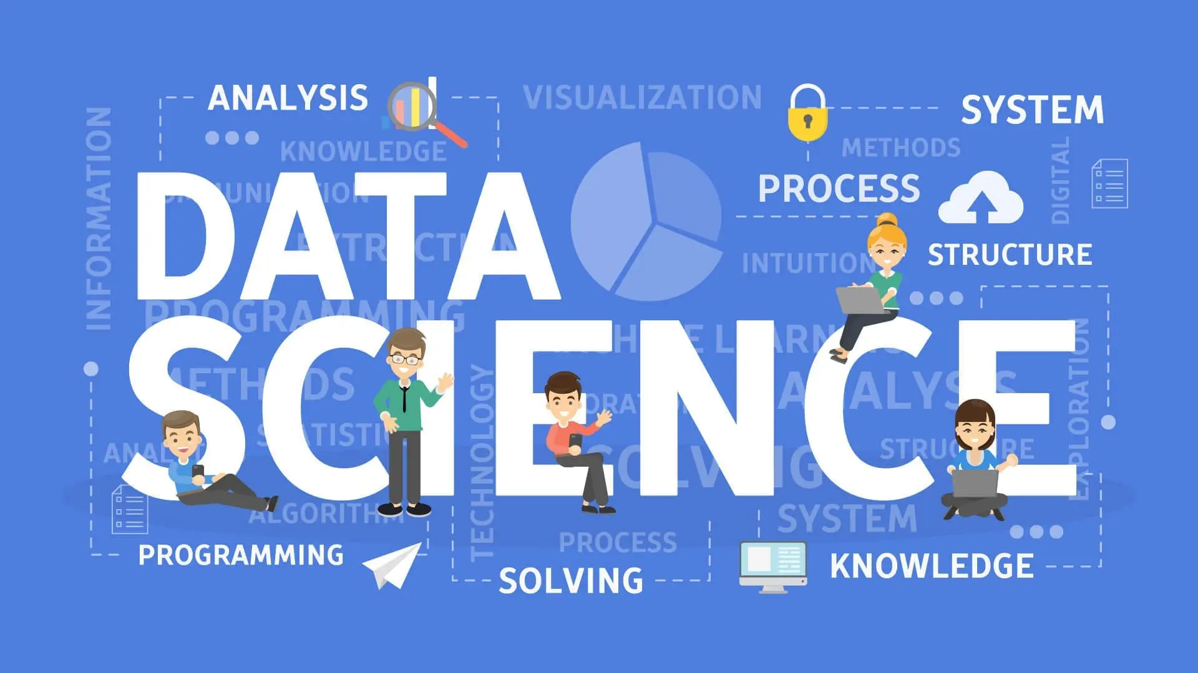
https://www.dataquest.io/blog/what-is-data-science/

Slide 6
What is data science?
Sources: https://towardsdatascience.com/what-is-data-science-8c8fbaef1d37, https://towardsdatascience.com/the-data-scientists-toolbox-part-1-c214adcc859f,https://ourworldindata.org/grapher/daily-covid-deaths-per-million-7-day-average?time=2020-07-07..&country=CAN~DEU~ITA~JPN~KOR~GBR~USA~ESP
Notes:
37

Slide 7
What is data science?
Answers can be confusing …
  statistics dressed up in fancy clothes
  statistics on a Mac
  a data scientist has been called a data analyst who lives in California
In broad terms, Data Science is about using data to answer questions
Sources: https://towardsdatascience.com/what-is-data-science-8c8fbaef1d37, https://towardsdatascience.com/the-data-scientists-toolbox-part-1-c214adcc859f,https://ourworldindata.org/grapher/daily-covid-deaths-per-million-7-day-average?time=2020-07-07..&country=CAN~DEU~ITA~JPN~KOR~GBR~USA~ESP
Notes:
37

Slide 8
What is data science?
Answers can be confusing …
  statistics dressed up in fancy clothes
  statistics on a Mac
  a data scientist has been called a data analyst who lives in California
In broad terms, Data Science is about using data to answer questions
Sources: https://towardsdatascience.com/what-is-data-science-8c8fbaef1d37, https://towardsdatascience.com/the-data-scientists-toolbox-part-1-c214adcc859f,https://ourworldindata.org/grapher/daily-covid-deaths-per-million-7-day-average?time=2020-07-07..&country=CAN~DEU~ITA~JPN~KOR~GBR~USA~ESP
Notes:
37

Slide 9
What is data science?
Answers can be confusing …
  statistics dressed up in fancy clothes
  statistics on a Mac
  a data scientist has been called a data analyst who lives in California
In broad terms, Data Science is about using data to answer questions
Sources: https://towardsdatascience.com/what-is-data-science-8c8fbaef1d37, https://towardsdatascience.com/the-data-scientists-toolbox-part-1-c214adcc859f,https://ourworldindata.org/grapher/daily-covid-deaths-per-million-7-day-average?time=2020-07-07..&country=CAN~DEU~ITA~JPN~KOR~GBR~USA~ESP
Notes:
37

Slide 10
What is data science?
Answers can be confusing …
  statistics dressed up in fancy clothes
  statistics on a Mac
  a data scientist has been called a data analyst who lives in California
In broad terms, Data Science is about using data to answer questions
Sources: https://towardsdatascience.com/what-is-data-science-8c8fbaef1d37, https://towardsdatascience.com/the-data-scientists-toolbox-part-1-c214adcc859f,https://ourworldindata.org/grapher/daily-covid-deaths-per-million-7-day-average?time=2020-07-07..&country=CAN~DEU~ITA~JPN~KOR~GBR~USA~ESP
Notes:
37

Slide 11
What is data science?
Answers can be confusing …
  statistics dressed up in fancy clothes
  statistics on a Mac
  a data scientist has been called a data analyst who lives in California
In broad terms, Data Science is about using data to answer questions
Sources: https://towardsdatascience.com/what-is-data-science-8c8fbaef1d37, https://towardsdatascience.com/the-data-scientists-toolbox-part-1-c214adcc859f,https://ourworldindata.org/grapher/daily-covid-deaths-per-million-7-day-average?time=2020-07-07..&country=CAN~DEU~ITA~JPN~KOR~GBR~USA~ESP
Notes:
37

Slide 12
What is data science?
Specifically, a data science project has one of three goals — either to provide insight, establish causality, or make predictions
These three goals are associated with the domains of data analysis, statistics, and machine learning.
Sources: https://towardsdatascience.com/what-is-data-science-8c8fbaef1d37, https://towardsdatascience.com/the-data-scientists-toolbox-part-1-c214adcc859f,https://ourworldindata.org/grapher/daily-covid-deaths-per-million-7-day-average?time=2020-07-07..&country=CAN~DEU~ITA~JPN~KOR~GBR~USA~ESP
Notes:
37

Slide 13
What is data science?
Specifically, a data science project has one of three goals — either to provide insight, establish causality, or make predictions
These three goals are associated with the domains of data analysis, statistics, and machine learning.
Sources: https://towardsdatascience.com/what-is-data-science-8c8fbaef1d37, https://towardsdatascience.com/the-data-scientists-toolbox-part-1-c214adcc859f,https://ourworldindata.org/grapher/daily-covid-deaths-per-million-7-day-average?time=2020-07-07..&country=CAN~DEU~ITA~JPN~KOR~GBR~USA~ESP
Notes:
37

Slide 14
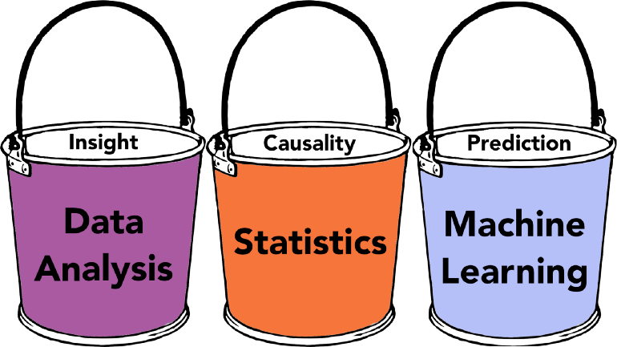
What is data science?
Specifically, a data science project has one of three goals — either to provide insight, establish causality, or make predictions.
These three goals are associated with the domains of data analysis, statistics, and machine learning.
Sources: https://towardsdatascience.com/what-is-data-science-8c8fbaef1d37, https://towardsdatascience.com/the-data-scientists-toolbox-part-1-c214adcc859f,https://ourworldindata.org/grapher/daily-covid-deaths-per-million-7-day-average?time=2020-07-07..&country=CAN~DEU~ITA~JPN~KOR~GBR~USA~ESP
Notes:
37

Slide 15
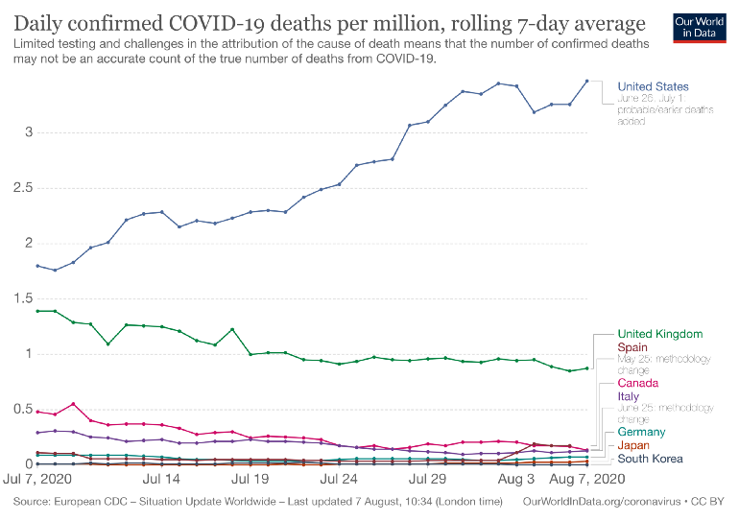
What is data science?
Sources: https://towardsdatascience.com/what-is-data-science-8c8fbaef1d37, https://towardsdatascience.com/the-data-scientists-toolbox-part-1-c214adcc859f,https://ourworldindata.org/grapher/daily-covid-deaths-per-million-7-day-average?time=2020-07-07..&country=CAN~DEU~ITA~JPN~KOR~GBR~USA~ESP
Notes:
37

Slide 16
Data science and CoTaPP
CoTaPP is not a data science course
But, you are getting some foundations for data science
  Python
  Collecting/working with data
  Libraries for data science
A Road Map for Data Science: https://towardsdatascience.com/a-road-map-for-data-science-d1977504a72b
Notes:
37

Slide 17
Data science and CoTaPP
CoTaPP is not a data science course
But, you are getting some foundations for data science
  Python
  Collecting/working with data
  Libraries for data science
A Road Map for Data Science: https://towardsdatascience.com/a-road-map-for-data-science-d1977504a72b
Notes:
37

Slide 18
Data science and CoTaPP
CoTaPP is not a data science course
But, you are getting some foundations for data science
  Python
  Collecting/working with data
  Libraries for data science
A Road Map for Data Science: https://towardsdatascience.com/a-road-map-for-data-science-d1977504a72
Notes:
37

Slide 19
Data science and CoTaPP
CoTaPP is not a data science course
But, you are getting some foundations for data science
  Python
  Collecting/working with data
  Libraries for data science
A Road Map for Data Science: https://towardsdatascience.com/a-road-map-for-data-science-d1977504a72b
Notes:
37

Slide 20
Data science and CoTaPP
CoTaPP is not a data science course
But, you are getting some foundations for data science
  Python
  Collecting/working with data
  Libraries for data science
A Road Map for Data Science: https://towardsdatascience.com/a-road-map-for-data-science-d1977504a72b
Notes:
37

Slide 21
Data science and CoTaPP
CoTaPP is not a data science course
But, you are getting some foundations for data science
  Python
  Collecting/working with data
  Libraries for data science
A Road Map for Data Science: https://towardsdatascience.com/a-road-map-for-data-science-d1977504a72b
Notes:
37

Slide 22
Approaching Data Analysis Problems: CRISP-DM
How to approach complex data analysis problems?
  Cross-Industry Standard Process for Data Mining
CRISP-DM provides a reference model describing how data mining experts typically proceed to address their problems
It gives orientation which steps to perform in a data science project
It divides the process into six major phases
Notes:
37

Slide 23
Approaching Data Analysis Problems: CRISP-DM
How to approach complex data analysis problems?
  Cross-Industry Standard Process for Data Mining
CRISP-DM provides a reference model describing how data mining experts typically proceed to address their problems
It gives orientation which steps to perform in a data science project
It divides the process into six major phases
Notes:
37

Slide 24
Approaching Data Analysis Problems: CRISP-DM
How to approach complex data analysis problems?
  Cross-Industry Standard Process for Data Mining
CRISP-DM provides a reference model describing how data mining experts typically proceed to address their problems
It gives orientation which steps to perform in a data science project
It divides the process into six major phases
Notes:
37

Slide 25
Approaching Data Analysis Problems: CRISP-DM
How to approach complex data analysis problems?
  Cross-Industry Standard Process for Data Mining
CRISP-DM provides a reference model describing how data mining experts typically proceed to address their problems
It gives orientation which steps to perform in a data science project
It divides the process into six major phases
Notes:
37

Slide 26
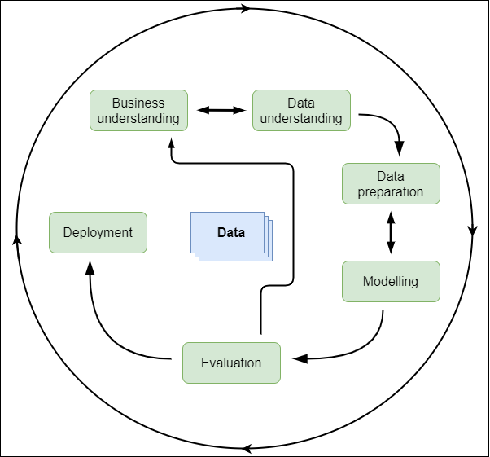
life cycle of a project
https://commons.wikimedia.org/w/index.php?curid=24930610

Slide 27
1. Business Understanding
Initial phase
Understand / define the general project objectives from a “business” or research perspective
Which (research) questions should the data analysis project answer?
Setup of a project plan
Notes:
37

Slide 28
2. Data Understanding
Become familiar with the available data
Collect, describe, and explore initial data for the project objectives
Discover first insights into the data
Verify the quality of the data.
Notes:
37

Slide 29
3. Data Preparation
Turn the initial data set into the final data set that will be used for the analysis
Depending on the situation, this might include
  selecting,
  cleaning,
  constructing,
  integrating (merge) and
  formatting data to make them ready for further processing
Notes:
37

Slide 30
4. Modeling
Select the analysis techniques to be used on the data set
Describe the overall computational process (e.g. with UML Activity Diagrams)
Do the implementation (e.g. with Python)
Execute on the prepared data set
Notes:
37

Slide 31
5. Evaluation
Critically review
  the computational model
  program and
  results
Are they correct?
Do they achieve the project objectives?
If not, the previous phases should be applied again to identify and eliminate the problems.
Notes:
37

Slide 32
6. Deployment
Deploy the final data, process, program, results and project report
Plan making for monitoring and maintenance of data and software artifacts
Review of the complete project
Notes:
37

Slide 33
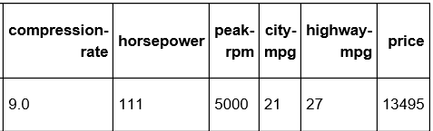
Quick Example: Predict Car Prices
https://medium.com/@christophberns/using-crisp-dm-to-predict-car-prices-f15eb5b14025
1. Business Understanding | A car dealer needs to estimate what the price of a used car could be. Can the price of a car be predicted based in its attribute with reasonable accuracy?
2. Data Understanding
3. Data Preparation | Replace a missing value in a column by the average of all other values in that column
4. Modeling | To come up with a model for predicting the price based on the other features, use the k-nearest neighbors (kNN) algorithm
5. Evaluation | To evaluate the performance of the kNN model, use a metric to valuate how accurate are the predictions of the model
6. Deployment | If the model is good, give it to the car dealer

Slide 34
Python Libraries for Data Science
Pandas
  Data manipulation and analysis
  Data frame
Numpy
  Support for large, multi-dimensional arrays and matrices
Matplotlib
  Plots

Slide 35


Slide 36
To Do
Exercises for the week
  Use quarterfall to submit them
Work in Project 2
Study for the midterm
Practice practice practice!
Ask questions!

Slide 37
Next lecture
Accessing remote resources

